Slide 1
Unit IV Programming Model

Slide 2
12 MARKS = 6 QUESTION
Parallel Programming Paradigm
Distributed Programming Paradigms
MapReduce
Hadoop ecosystem
Cloud Software Environments - Eucalyptus, Open Nebula, Open Stack, Aneka, Cloud Sim
Google App Engine, Amazon AWS

Slide 3
Parallel Programming Paradigm:
Parallel and distributed programming paradigms are approaches used to design and implement software that can execute tasks concurrently across multiple computing resources.
They cater to different computing scenarios and aim to improve performance, scalability, and efficiency in handling complex computational problems

Slide 4
The most popular parallel programming:
Shared memory
Distributed memory
Data parallelism
Task parallelism
Functional parallelism
Actor model

Slide 5
1. Shared memory
The shared memory paradigm is based on the idea that multiple threads or processes can access and modify the same memory space, without explicitly sending messages or data.
This paradigm is suitable for parallelizing applications that have a high degree of data locality, where the data accessed by different threads or processes are close to each other in memory.
However, the shared memory paradigm also requires careful management of concurrency and consistency, as multiple threads or processes may try to read or write the same memory location at the same time.
To prevent data races and ensure atomicity, the shared memory paradigm relies on mechanisms such as locks, semaphores, barriers, or atomic operations.

Slide 6
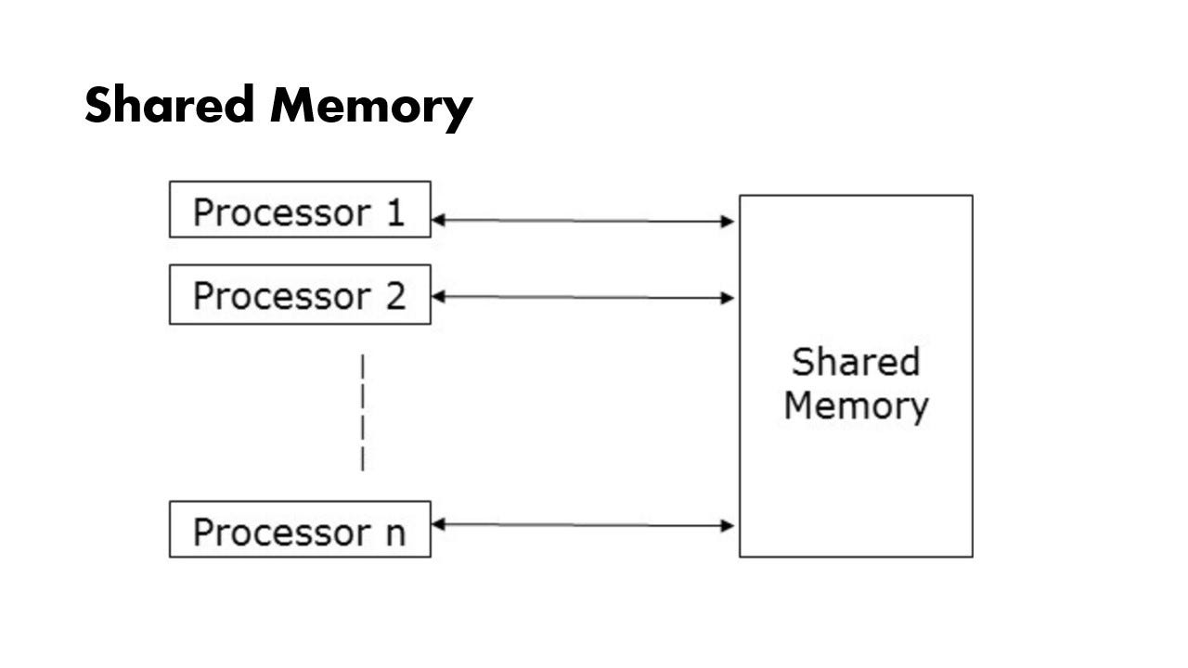

Slide 7
2. Distributed memory
The distributed memory paradigm is based on the idea that multiple processors or machines have their own private memory spaces, and can only communicate with each other by explicitly sending and receiving messages or data.
This paradigm is suitable for parallelizing applications that have a low degree of data locality, where the data accessed by different processors or machines are far apart in memory.
However, the distributed memory paradigm also requires careful management of communication and synchronization, as sending and receiving messages or data may incur significant overhead and latency.
To optimize communication and synchronization, the distributed memory paradigm relies on mechanisms such as collective operations, message passing libraries, or remote procedure calls.

Slide 8
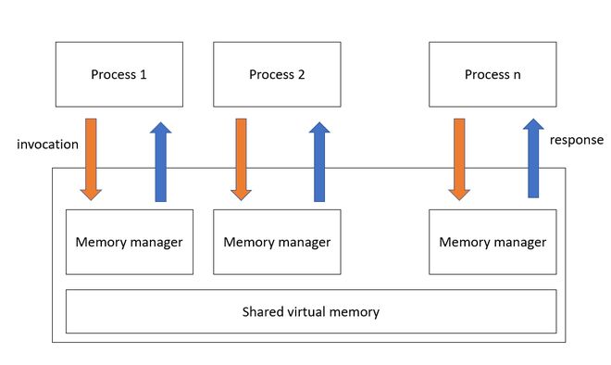

Slide 9
3. Data parallelism
The data parallelism paradigm is based on the idea that multiple threads or processes can perform the same operation on different chunks(group) of data in parallel.
This paradigm is suitable for parallelizing applications that have a high degree of data parallelism, where the same computation can be applied to different data elements independently.
However, the data parallelism paradigm also requires careful management of data distribution and load balancing, as different chunks of data may have different sizes or complexities.
To ensure data distribution and load balancing, the data parallelism paradigm relies on mechanisms such as partitioning, replication, or redistribution.

Slide 10
4. Task parallelism
The task parallelism paradigm is based on the idea that multiple threads or processes can perform different operations on different data in parallel.
This paradigm is suitable for parallelizing applications that have a high degree of task parallelism, where different computations can be performed on different data elements concurrently.
However, the task parallelism paradigm also requires careful management of task dependency and coordination, as different tasks may have different inputs, outputs, or precedence relationships.
To ensure task dependency and coordination, the task parallelism paradigm relies on mechanisms such as scheduling, dependency graphs, or futures.

Slide 11
5. Functional parallelism
The functional parallelism paradigm is based on the idea that multiple threads or processes can execute different functions or subroutines in parallel.
This paradigm is suitable for parallelizing applications that have a high degree of functional parallelism, where different functions or subroutines can be executed on different data elements or parameters independently.
However, the functional parallelism paradigm also requires careful management of functional purity and side effects, as different functions or subroutines may have different effects on the global state or environment.
To ensure functional purity and side effects, the functional parallelism paradigm relies on mechanisms such as immutability, referential transparency, or monads.

Slide 12
6. Actor model
The actor model paradigm is based on the idea that multiple actors can interact with each other by sending and receiving messages in parallel. An actor is an entity/group that has a unique identity, a private state, and a behavior that defines how it responds to messages.
This paradigm is suitable for parallelizing applications that have a high degree of concurrency and distribution, where different actors can operate on different data elements or parameters asynchronously.
However, the actor model paradigm also requires careful management of actor creation and termination, as well as message delivery and ordering.
To ensure actor creation and termination, as well as message delivery and ordering, the actor model paradigm relies on mechanisms such as supervision, location transparency, or event sourcing.

Slide 13
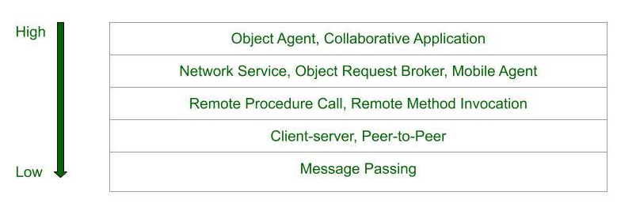
Distributed Programming Paradigms
Paradigm means an idea or pattern.
In below, we will see the classification of the paradigms for distributed applications. The classification of the paradigms for distributed applications.
Level of Abstraction:

Slide 14
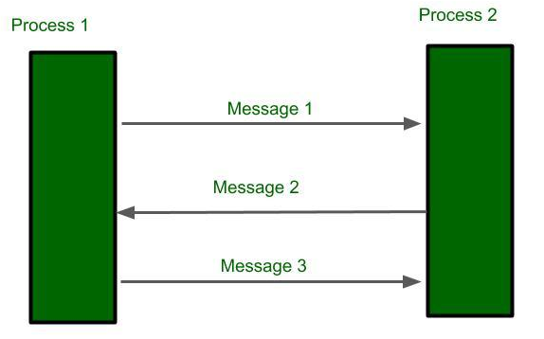
Message Passing Paradigm:
It is a basic approach for Inter Process Communication. The data exchange between the sender and the receiver. A process sends a message representing the request. The receiver receives and processes it then sends back as reply.
Operations: send, receive
Connections: connect, disconnect

Slide 15
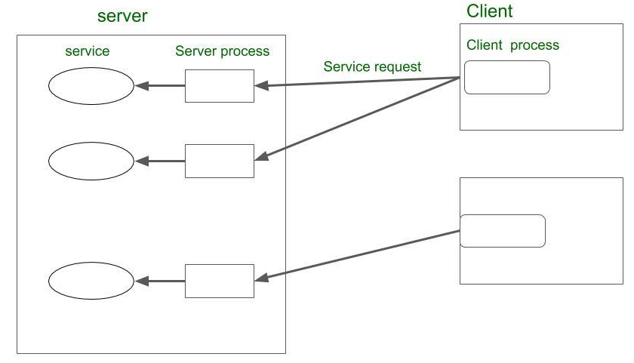
Client Server Paradigm:
In this approach, the server acts as a service provider, the client issues the request and wait for the response from the server. Here server is dump machine. Until client make a call server doesn’t communicate. Many Internet services are client-server applications.
Server Process: listen, accept
Client Process: issue the request, accept the response

Slide 16
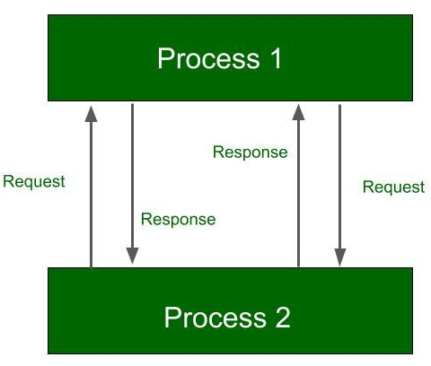
Peer to Peer Paradigm:
Direct communication between processes. Here is no client or server, anyone can make request to others and get the response.
Example: A well-known example of a peer-to-peer file transfer.

Slide 17
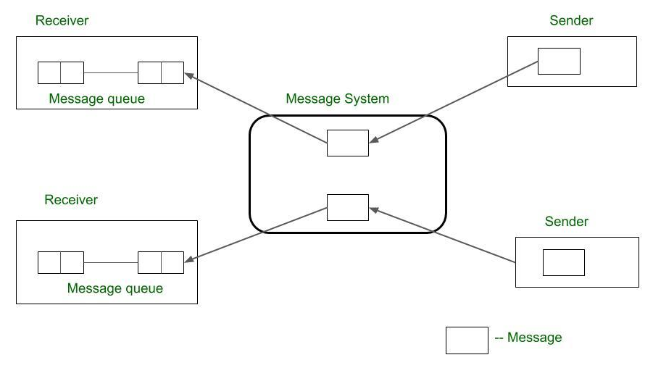
Message System Paradigm:
Message system act as intermediate among independent processes. It is also act as switch through which process exchange messages asynchronously in decoupled manner. sender sends message which drop at first in message system then forward to message queue which is associated with the receiver.

Slide 18
Types:
Point to Point message model
Publish/Subscribe model
Point to Point message model:
Forward message from sender to receiver via message system. The message system keeps repository of messages and directly forward messages to the receiver’s message queue. Unlike the basic message-passing model, it provides asynchronous message passing.
Public/Subscribe Model:
In this model, each message is associated with a specific topic or event. whoever interest in the messages can subscribe to the event before it occurs. When the waited event occurs, the process publishes the message with an event or topic. Then the message system distributes messages to all the subscribers.
Example: IBM MQ service, Microsoft Message Queuing

Slide 19
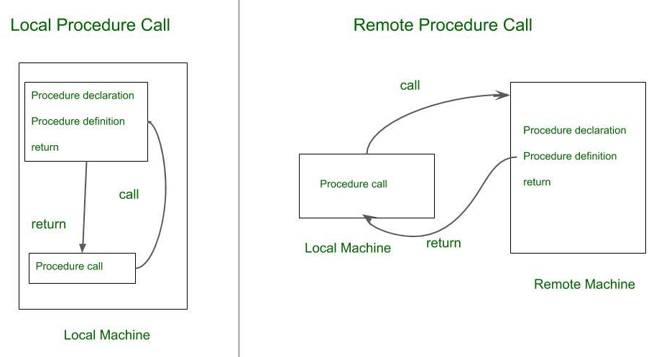
Remote Procedure Call:
Local procedure call happens only within a local machine.
Remote Procedure call(RPC) happens between two remote machines.

Slide 20
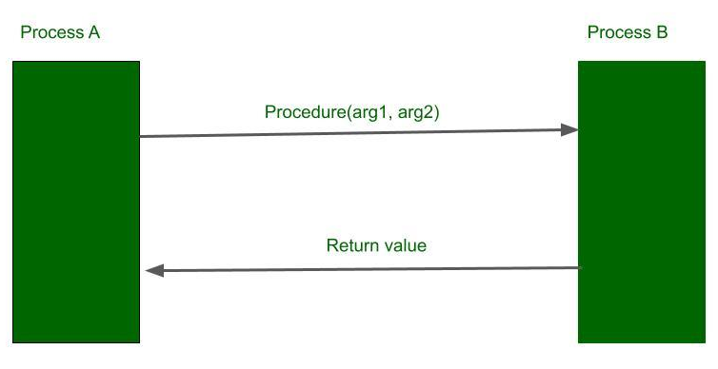
A client application can call a server-side function on a remote machine to perform a task and get the result back
RPC ( Remote Procedure Call ) involves two independent processes that may reside on a separate machine. Process A wishing to make a request process B for procedure call with a list of arguments. Process B operates the procedure and return values to Process A.

Slide 21
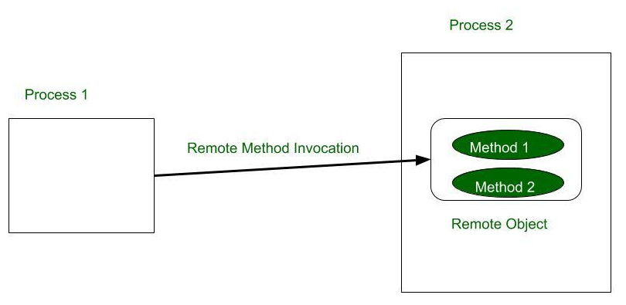
Distributed Object Paradigm:
Application access the objects distributed over the network. Objects provide methods, through the invocation of which an application obtains access to services.
Types:
Remote Method Invocation (RMI)
Object Request Broker
Object Space
Remote Method Invocation:
RMI is more like RPC but major difference is, it is object-oriented approach.
A process invokes the methods in an object, which may reside in a remote host. Arguments may be passed with the invocation.

Slide 22
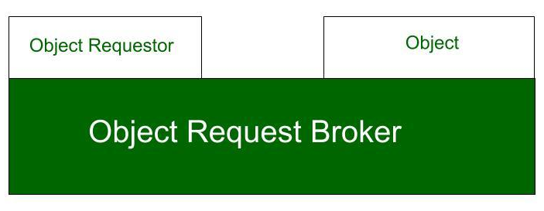
Object Request Broker (ORB):
ORB acts as mediator between objects and object requester, it allows requester can access multiple remote objects. An application issues requests to an object request broker (ORB), which directs the request to an appropriate object that provides service.
Example: CORBA

Slide 23
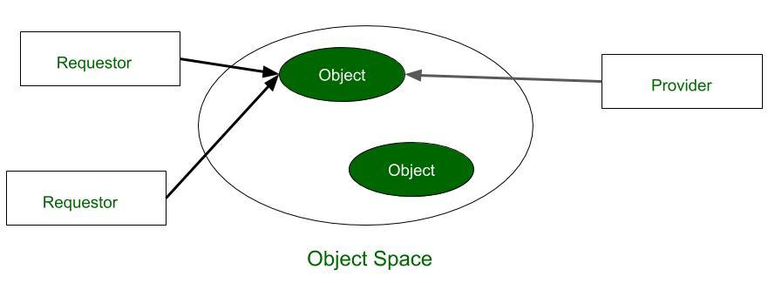
Object Space:
Objects are placed as logical entities in the space called object space. Providers place their objects entries in the objects space. Requests who subscribe can access the objects.

Slide 24
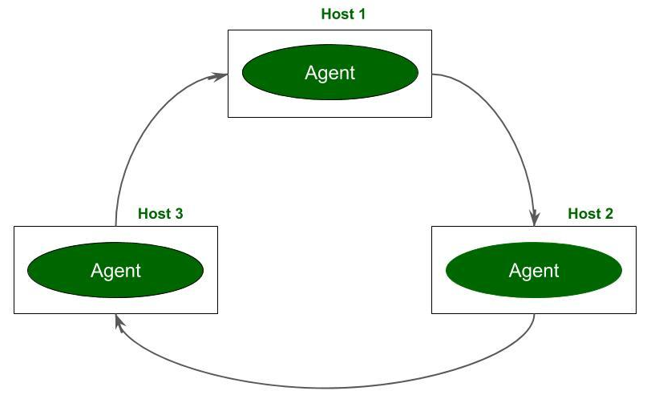
Mobile Agent Paradigm:
Mobile agent starts from originated host and transports over host to host. At each host, the agent can access the services or resources to complete the mission.

Slide 25
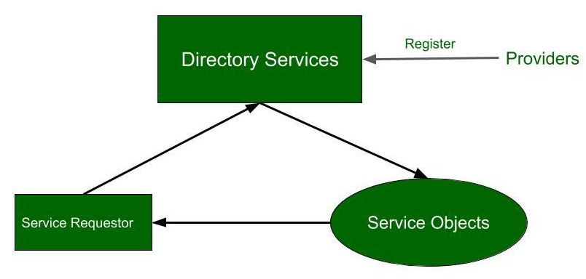
Network Service Paradigm:
All the service objects are register with global directory service. If process want a service can/should contact directory service at runtime. Requestor is provided a reference, using which process interact with service. services are identified by the global unique identifier.
Example: Java Jini

Slide 26
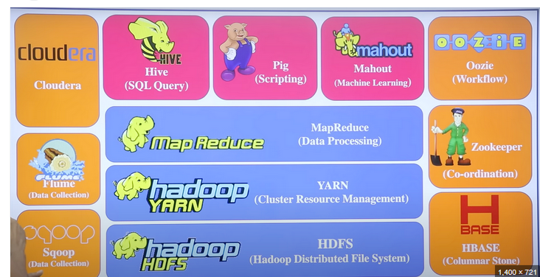
Hadoop Ecosystem:
The Hadoop ecosystem is a collection of open-source tools and frameworks built
around the core Apache Hadoop project, designed for storing and processing
vast amounts of data across distributed computer clusters.

Slide 27
MapReduce
MapReduce is a programming model that uses parallel processing to speed large-scale data processing. MapReduce enables massive scalability across hundreds or thousands of servers within a Hadoop cluster.
The name "MapReduce" refers to the 2 tasks that the model performs to help “chunk” a large data processing task into many smaller tasks that can run faster in parallel.
First is the "map task," which takes one set of data and converts it into another set of data formatted as key/value pairs, such as cities (keys) and daily high temperatures (values).
Second is the "reduce task," which takes the outputs from a map task, aggregates all values with the same key and processes the data to produce a final set of key/value pairs.
The MapReduce programming model is one of the core processing components at the heart of Apache Hadoop, an open source software framework supported by the Apache Software Foundation and built on the Java programming language.
The MapReduce model can be used outside of Hadoop as well.

Slide 28
How MapReduce works
MapReduce helps chunk data processing projects into smaller pieces so they can run faster.
Using one processor to analyze a huge file with terabytes or petabytes of data might, for example, take 10 hours. A MapReduce job can split that same data file into 10 tasks that run in parallel on 10 processors. This job might only take an hour or less to run. The data can be aggregated from the distributed computing nodes to produce a result.
While mapping and reducing are the essential functions of the MapReduce model, the overall process includes a few more steps

Slide 29
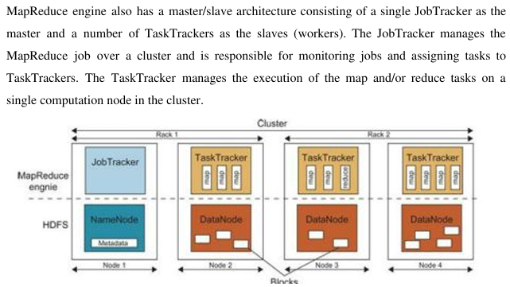
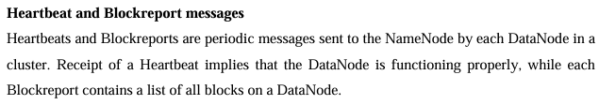

Slide 30
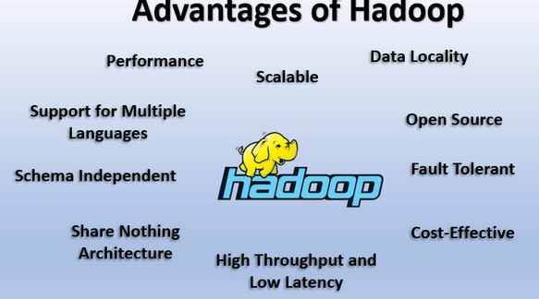
Input
A MapReduce application accepts input data, which can include structured or unstructured data. MapReduce applications usually work with input files stored in the Hadoop distributed file system (HDFS),
For a specific job, the MapReduce framework helps select distributed servers, manage communications and data transfers and support fault tolerance and redundancy.

Slide 31
Splitting
The input data is split into smaller blocks. These blocks are distributed to mappers—the functions that perform mapping in the next step—located across various computing nodes. The MapReduce framework aims for a roughly uniform assignment of data across mappers for efficient load balancing.
Mapping
On each node, the map function processes the data it receives, converting the data into key/value pairs.
The total number of mappers is determined within the Hadoop framework, based on the total volume of data and the available memory blocks on each mapper. Parameters for the mappers, reducers and output formats can be set within the Hadoop cluster.

Slide 32
Shuffling
The Hadoop framework sorts the map outputs and assigns all key/value pairs with the same "key" (topic) to the same reducer. For example, in a data set of cities and their daily high temperatures, any data with the “Tokyo” key would go to the same reducer.
The reducer, as the name suggests, is the function that performs the reduce step.
Reducing
Reduce functions process the key/value pairs that the mappers emit. This can involve merging, tabulating or performing other operations on the data, depending on the kind of processing required.
Mapping and reduction can be done on the same set of servers, but this is optional.
Result
Each reducer outputs the results of its processing to the HDFS or other data store.

Slide 33
An example of MapReduce
No matter the amount of data an organization wants to analyze, the key principles remain the same.
For this example, the data set includes cities (the keys) and the corresponding daily temperatures (the values) recorded for each city. A sample key/value pair might look like this: <Toronto, 18>.
The data is spread across multiple files. Each file might include data from a mix of cities, and it might include the same city multiple times.
From this data set, the user wants to identify the "maximum temperature" for each city across the tracked period.

Slide 34
An implementation of MapReduce to handle this job might look like this:
Data files containing temperature information feed into the MapReduce application as input.
The files are split into map tasks, with each task assigned to one of the mappers.
The mappers convert the data into key/value pairs.
The map outputs are shuffled and sorted so that all values with the same city key end up with the same reducer. For example, all temperature values for Toronto go to one reducer, while another reducer aggregates all the values for London.
Each reducer processes its data to determine the highest temperature value for each city. The data is then reduced to just the highest key/ value pair for each city.
After the reduce phase, the highest values can be collected to produce a result: <Tokyo, 38> <London, 27> <New York, 33> <Toronto, 32>.

Slide 35
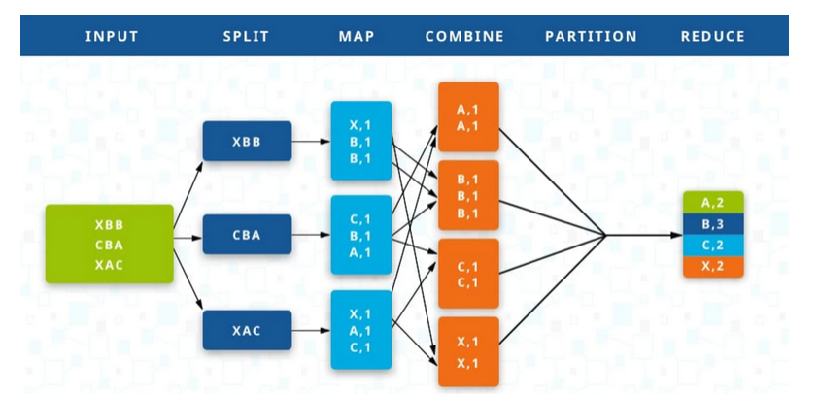

Slide 36
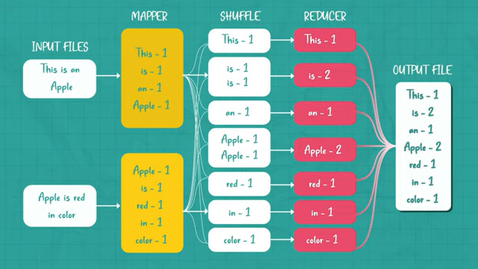

Slide 37
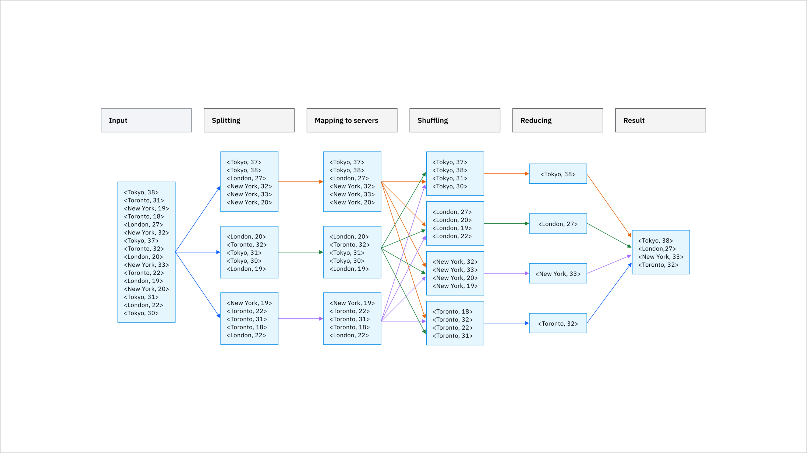

Slide 38
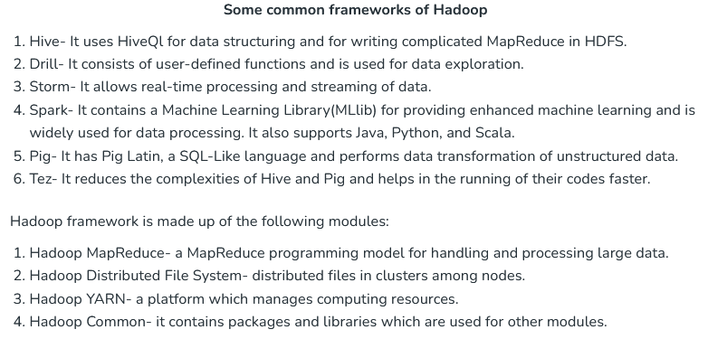

Slide 39
MapReduce within the Hadoop ecosystem
The Hadoop ecosystem is a suite of open source modules designed to work together to promote efficiency. There are modules that constitute the main Hadoop framework, including MapReduce plus 3 more:
Hadoop distributed file system (HDFS)
HDFS is a distributed file system for storing application data on up to thousands of commodity servers.
HDFS is designed to provide fault tolerance for Hadoop and provide fast access to data. By default, data blocks are replicated across multiple nodes at load or write time.
The HDFS architecture features a NameNode to manage the file system namespace and file access, along with multiple DataNodes to manage data storage.

Slide 40
Yet Another Resource Negotiator (YARN)
Open source Apache Hadoop, YARN, is a framework for job scheduling and cluster resource management. It supports multiple workloads, such as SQL queries, advanced modeling and real-time streaming.
Hadoop Common
This module is a collection of resource utilities and libraries that support other Hadoop modules. Also known as Hadoop Core, it includes multiple resources for automatic failure recovery, file-system-level and operating-system-level abstraction, Java Archive (JAR) files and scripts, plus more.

Slide 41
Mapping application(12 Marks)
A mapping application provides geographic data and tools to visualize, navigate, and analyze locations.
Examples include Google Maps, Apple Maps, and ArcGIS.
Introduction to Mapping Applications
Mapping applications are digital tools that provide access to geographic information and allow users to visualize, navigate, and interact with maps. These applications are widely used in various fields, such as transportation, urban planning, disaster management, and tourism.
Definition
A mapping application is a software program or online platform designed to display maps and provide tools for location-based services, navigation, and geographic analysis.

Slide 42
Key Features of Mapping Applications
Map Visualization
Displays maps in various formats like street maps, satellite imagery, and terrain maps.
Allows users to zoom in/out, pan, and rotate views.
Location Search
Enables users to find specific places like addresses, businesses, or landmarks.
Navigation and Routing
Provides directions for walking, driving, cycling, or public transport.
Real-time updates on traffic, road closures, and alternate routes.

Slide 43
Layer Integration
Includes additional data layers such as weather, population density, or points of interest.
Useful in professional mapping tools like ArcGIS or QGIS.
Customization
Allows users to mark locations, draw areas, or create custom routes.
Offline Functionality
Maps can be downloaded for use without an internet connection.
Real-Time Information
Updates users on traffic, weather, and live events in the mapped area.

Slide 44
Types of Mapping Applications
Navigation Apps
Focus on route planning and real-time navigation.
Examples: Google Maps, Waze, Apple Maps.
Professional GIS Tools
Designed for spatial analysis and research.
Examples: ArcGIS, QGIS.
Custom Mapping Platforms
Allow creation of personalized maps for specific projects.
Examples: Mapbox, OpenStreetMap.
Specialized Mapping Apps
Serve niche needs like hiking (AllTrails), weather tracking, or real estate.

Slide 45
Mapping application
Advantages
Easy access to geographic data.
Improves efficiency in travel and planning.
Provides real-time updates and data.
User-friendly interfaces.
Challenges
Requires internet for live data in most cases.
Privacy concerns due to location tracking.
Limited accuracy in remote areas.

Slide 46
Google App Engine and Amazon AWS
Introduction
Modern cloud platforms like Google App Engine and Amazon AWS provide comprehensive programming support to developers, enabling them to build, deploy, and manage applications without worrying about underlying infrastructure. These platforms offer scalability, flexibility, and integration with various tools for enhanced productivity.

Slide 47
1. Google App Engine (GAE)
Definition
Google App Engine (GAE) is a Platform-as-a-Service (PaaS) offering by Google that allows developers to build and deploy web applications at scale. It supports multiple programming languages and provides an environment for hosting applications in Google’s cloud infrastructure. App Engine offers automatic scaling for web applications—as the number of requests increases for an application, App Engine automatically allocates more resources for the web application to handle the additional demand.
Key Features
Managed Environment
Developers focus on coding while Google handles the infrastructure.
Automatic scaling based on traffic and demand.
Language Support
Supports Python, Java, Go, PHP, Node.js, Ruby, and more.

Slide 48
Integrated Services
Built-in APIs for email, storage, databases (Google Cloud Datastore, Firestore), and more.
Pay-As-You-Go
Charges are based on resources used, such as compute, storage, and traffic.
Version Control
Allows multiple application versions, making testing and updates easier.
Free ???
Yes, free for upto 1 GB of storage and enough CPU and bandwidth to support 5 million page views a month. 10 Applications per Google account.

Slide 49
Programming Workflow in GAE
Write code in a supported language.
Use Google Cloud SDK for local testing.
Deploy the application using the command line or web interface.
Monitor performance with integrated tools like Google Cloud Monitoring.
Use Cases/Applications
Web applications.
APIs and backend services.
E-commerce platforms.

Slide 50
2. Amazon AWS(4 Marks)
Definition
Amazon Web Services (AWS) is a comprehensive Infrastructure-as-a-Service (IaaS) and Platform-as-a-Service (PaaS) solution that provides developers with tools and infrastructure to build, deploy, and scale applications.
Key Features
Wide Range of Services
Offers over 200 services, including compute (EC2), storage (S3), databases (RDS, DynamoDB), and machine learning (SageMaker).
Global Infrastructure
Operates in multiple regions and availability zones for low latency and high reliability.

Slide 51
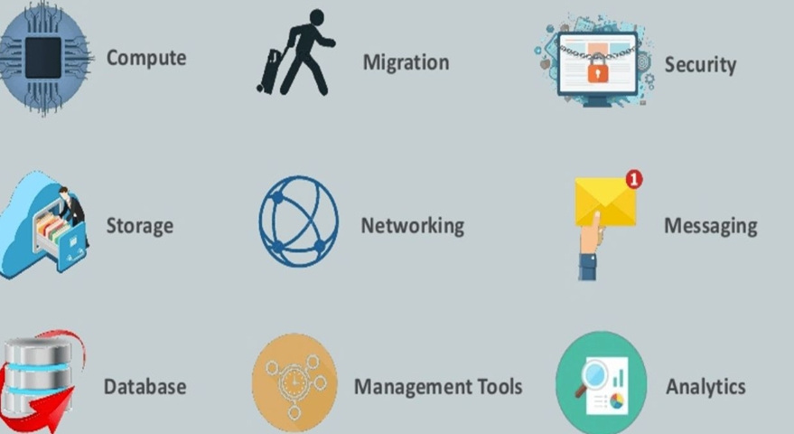

Slide 52
Programming Language Support
Compatible with all major programming languages, including Python, Java, .NET, JavaScript, and more.
Elastic Scaling
Automatically adjusts resources based on demand using services like Auto Scaling and Elastic Load Balancing.
Serverless Options
AWS Lambda allows code execution without provisioning servers.

Slide 53
Programming Workflow in AWS
Set up an AWS account and configure IAM (Identity and Access Management) for secure access.
Use the AWS SDK or CLI to interact with services programmatically.
Deploy applications using AWS services like EC2, Elastic Beanstalk (PaaS), or Lambda (serverless).
Monitor using tools like Amazon CloudWatch and AWS X-Ray.
Use Cases
Hosting websites and web applications.
Machine learning and AI services.
Data storage and analytics.
Internet of Things (IoT) applications.

Slide 54
Comparison of Google App Engine and Amazon AWS
Feature | Google App Engine | Amazon AWS
Service Type | PaaS | IaaS + PaaS
Scalability | Automatic | Elastic (configurable)
Language Support | Limited | Extensive
Flexibility | Limited customization | Highly flexible
Ease of Use | Simplified | Requires more setup and management
Best For | Small to medium applications | Applications of all sizes

Slide 55
Cloud Software Environments:(4 Marks)
1.Amazon Web Services (AWS): Provides a wide range of services across IaaS, PaaS, and SaaS models, including compute, storage, databases, machine learning, and more.
2.Microsoft Azure: Offers a comprehensive set of cloud services, including computing, analytics, AI, and developer tools, along with support for various programming languages and frameworks.
3.Google Cloud Platform (GCP): Provides a suite of cloud services for computing, storage, databases, machine learning, and application development, with tools like Google App Engine, Kubernetes, and more.

Slide 56
IBM Cloud: Offers a range of cloud services and tools for building, running, and managing applications and includes support for various industries and enterprise needs.
These cloud software environments empower developers and businesses to leverage scalable and cost-effective solutions, enabling innovation, rapid development, and efficient deployment of applications and services.

Slide 57
Eucalyptus, Open Nebula, Open Stack, Aneka, and Cloud Sim
Eucalyptus, OpenNebula, OpenStack, Aneka, and CloudSim are all platforms or tools related to cloud computing, but each serves different purposes within the cloud ecosystem.
1. Eucalyptus:
Eucalyptus is an open-source software platform that enables the building of private and hybrid clouds. It provides an Infrastructure as a Service (IaaS) solution, compatible with Amazon Web Services (AWS) APIs, allowing organizations to create their own AWS-compatible cloud environments within their data centers.
2. OpenNebula:
OpenNebula is an open-source cloud computing toolkit for managing and orchestrating virtualized data centers. It offers features for both private and hybrid cloud computing, providing services for storage, networking, and virtualization management.

Slide 58
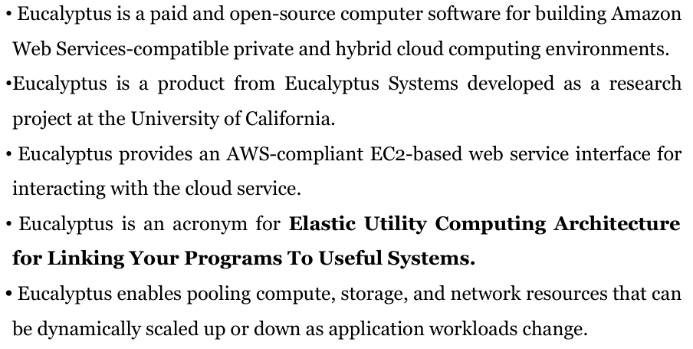

Slide 59
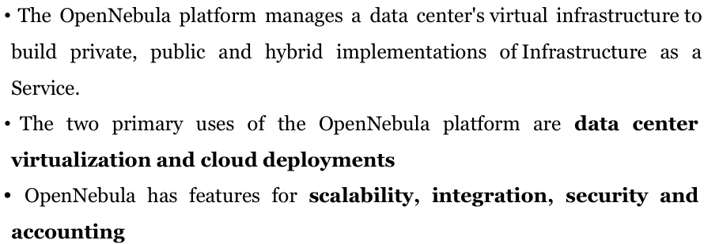

Slide 60
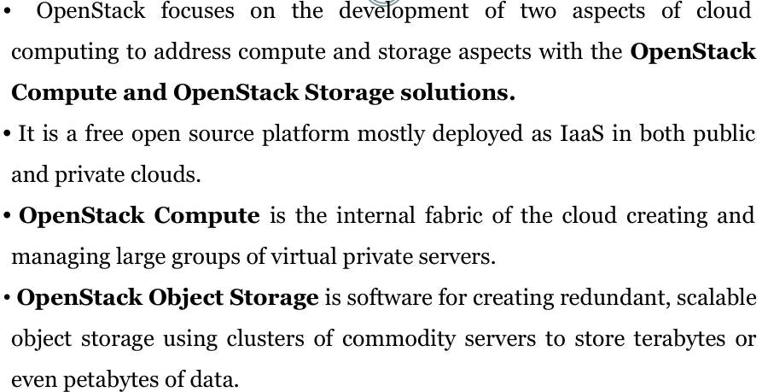
OpenStack is an open-source cloud computing platform that provides
a way to build and manage both public and private clouds

Slide 61
3. OpenStack:
OpenStack is a popular open-source cloud computing platform that offers a range of services for building and managing public and private clouds. It provides various components, including compute (Nova), storage (Swift for object storage and Cinder for block storage), networking (Neutron), and other services like identity management (Keystone) and dashboard (Horizon).
4. Aneka:
Aneka is a middleware platform that aims to simplify the development and deployment of applications in cloud environments, specifically targeting distributed and parallel computing applications. It offers a programming model and tools for managing distributed applications across various cloud infrastructures.

Slide 62
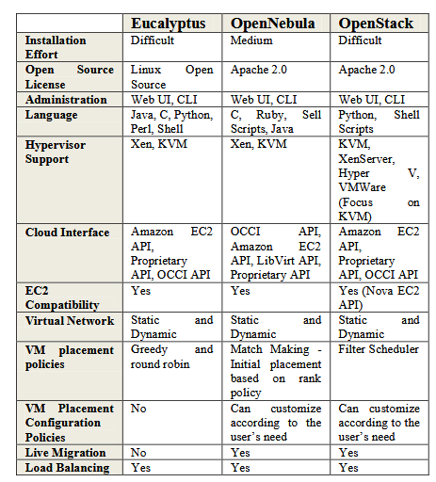
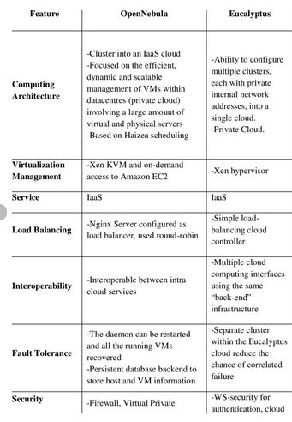

Slide 63
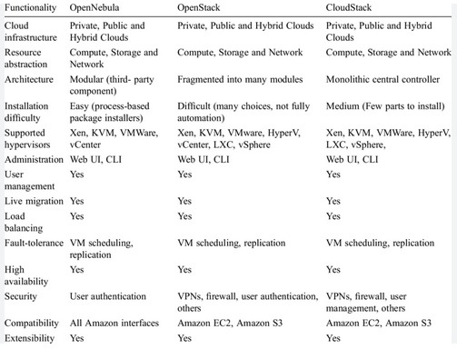

Slide 64
5. CloudSim:
CloudSim is a simulation framework used for modeling and simulating cloud computing infrastructures and services. It helps researchers and developers to evaluate and experiment with cloud computing concepts and algorithms without the need for an actual cloud infrastructure.
Each of these platforms and tools serves different needs within the cloud computing landscape.
While Eucalyptus and OpenNebula focus on managing private and hybrid clouds, OpenStack provides a more comprehensive set of services for both private and public clouds.
Aneka targets application development and deployment in distributed environments, while CloudSim is primarily a simulation tool for experimenting with cloud computing concepts in a virtual environment.
Organizations and developers often choose these tools based on their specific requirements, such as scalability, compatibility, ease of use, or the need for a particular set of services and functionalities within their cloud infrastructure.

Slide 65
